Slide 1
Weekly Report
6/30/2017
Alireza Khamesipour

Slide 2
Outline
SEM Report
SIU-ODIRS(Online-Degree Information Request System)

Slide 3
SEM
Quality Score:
Bid
Expected CTR
Ad relevance
Landing page experience
Effect of the Bid:
IST (20$) → IST (58$)
EST (0$) → EST (1$)
TRM (0$) → TRM (1$)

Slide 4
Ad Relevance
Keywords
Effectiveness by bid simulator

Slide 5
Landing page experience
Successful SIU website Platforms
Based on successful Local websites (Liz Hunter – Lead Web Strategist)

Slide 6
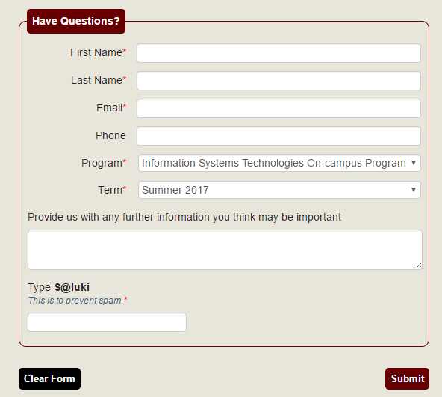
SIU - ODIRS
Console without Database
Console with Database

